Slide 1
Who’s ready to drive?

Slide 2
Parent/Guardian Paper
Take the sheet home and discuss with your parent/guardian
Explains Blue Slip, White Slip and No Slip
Also gives them our email addresses if they have any questions

Slide 3
Driving Card
Staple to your planner so you do not lose it
Lists –Dates, Day and Period you drive
Please check all days and periods listed for any potential conflicts. If there is a conflict we need to know as soon as possible so that we can try to make an adjustment to the driving schedule.

Slide 4
Driving Card
At the bottom of the card it states
  Please provide 24 hour notice to teachers
  If not teachers can say NO
If you are driving tomorrow you need to see that teacher today to give them notice

Slide 5
Driving Card
If today is ODD get all of your ODD teachers to sign
If today is EVEN get all of our EVEN teachers to sign
Tomorrow fill in the rest

Slide 6
The Day You Drive
You will report to your class first each day you drive to remind the teacher you are driving or if there is a substitute to let them know. Then report directly to our classroom.
If you are driving during Period 1 or 2 STAY until the TV announcement are finished before you report to our classroom.

Slide 7
The Day You Drive
Proper footwear
  No boots, flip flops or sandals
  Your shoes must be able to stay on your feet
  You may bring a different pair to change into before driving

Slide 8
Back of Driving Card
Please look at the label and follow the directions

Slide 9
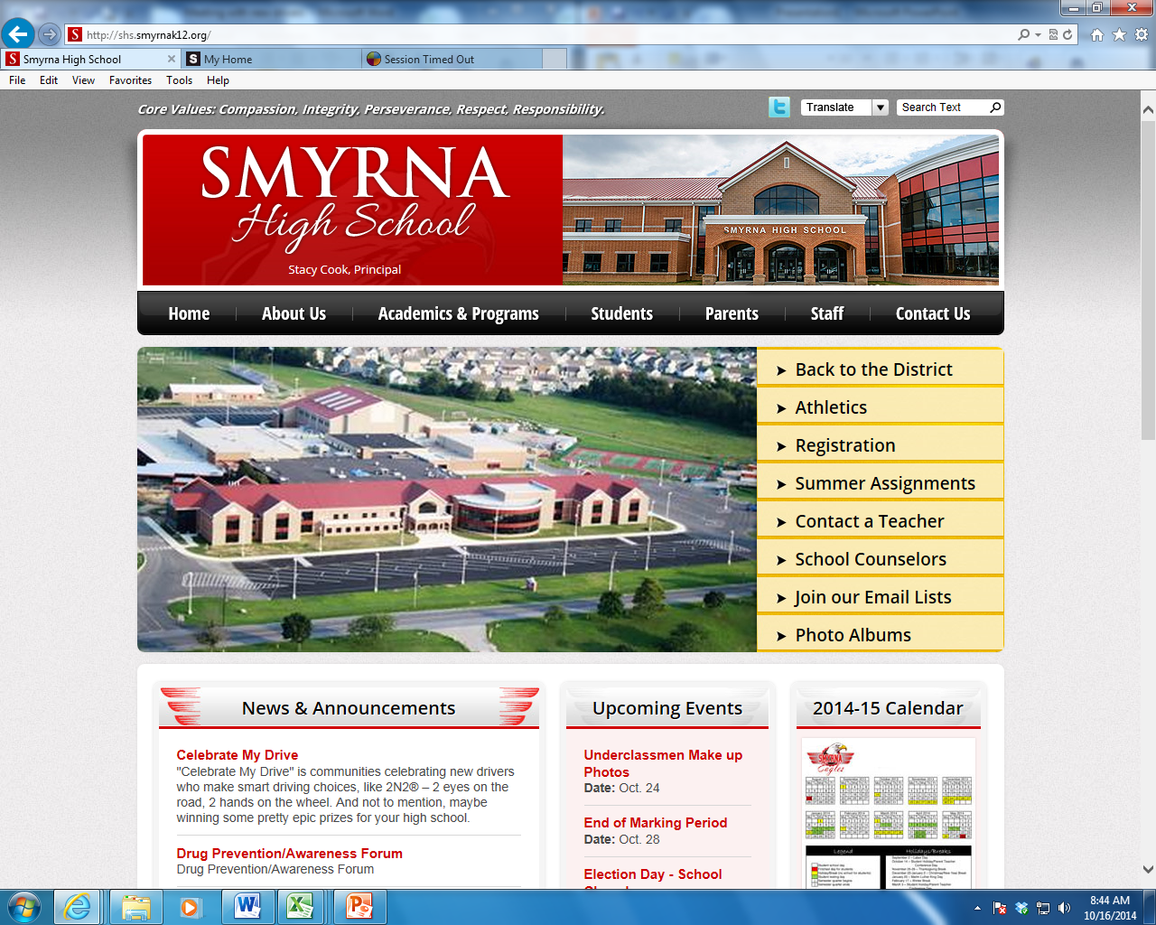
Click Academics & Programs

Slide 10
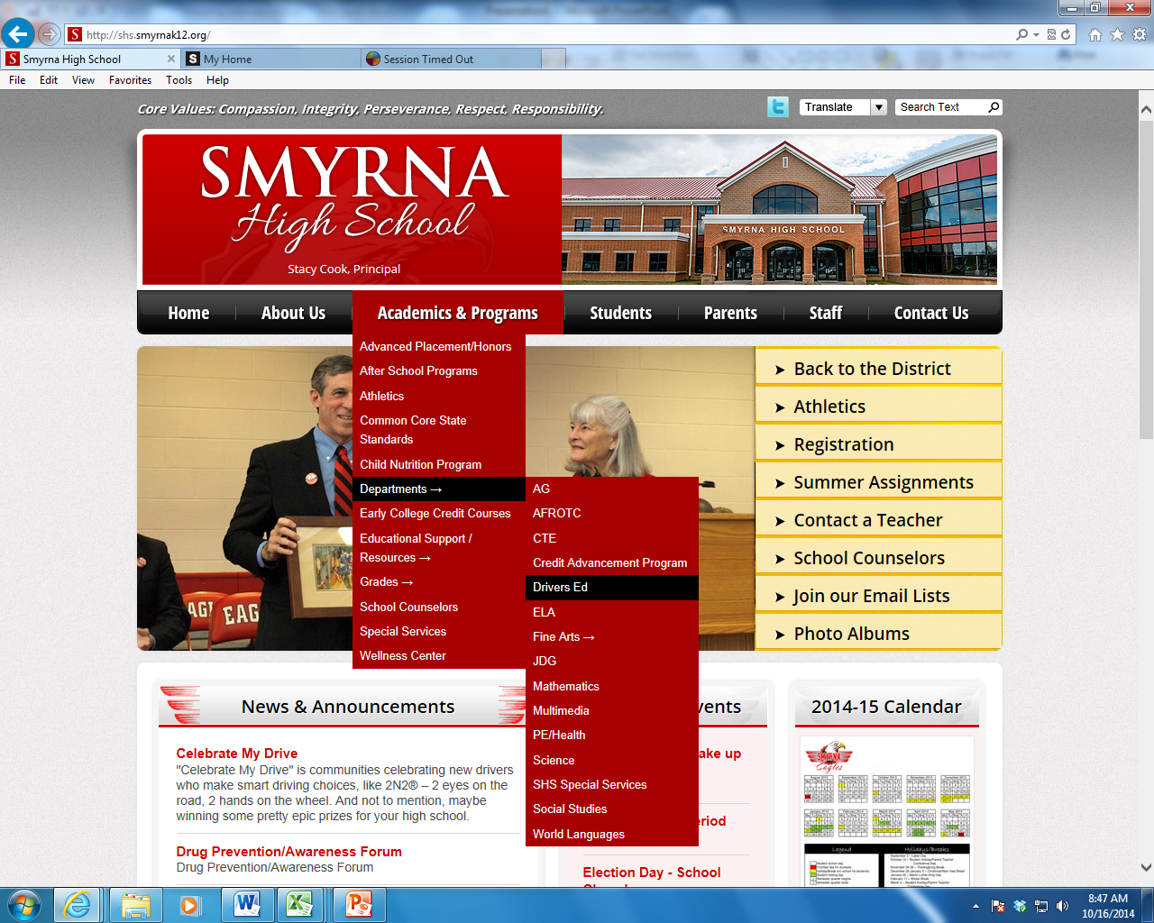
Click Departments
Click Driver Ed

Slide 11
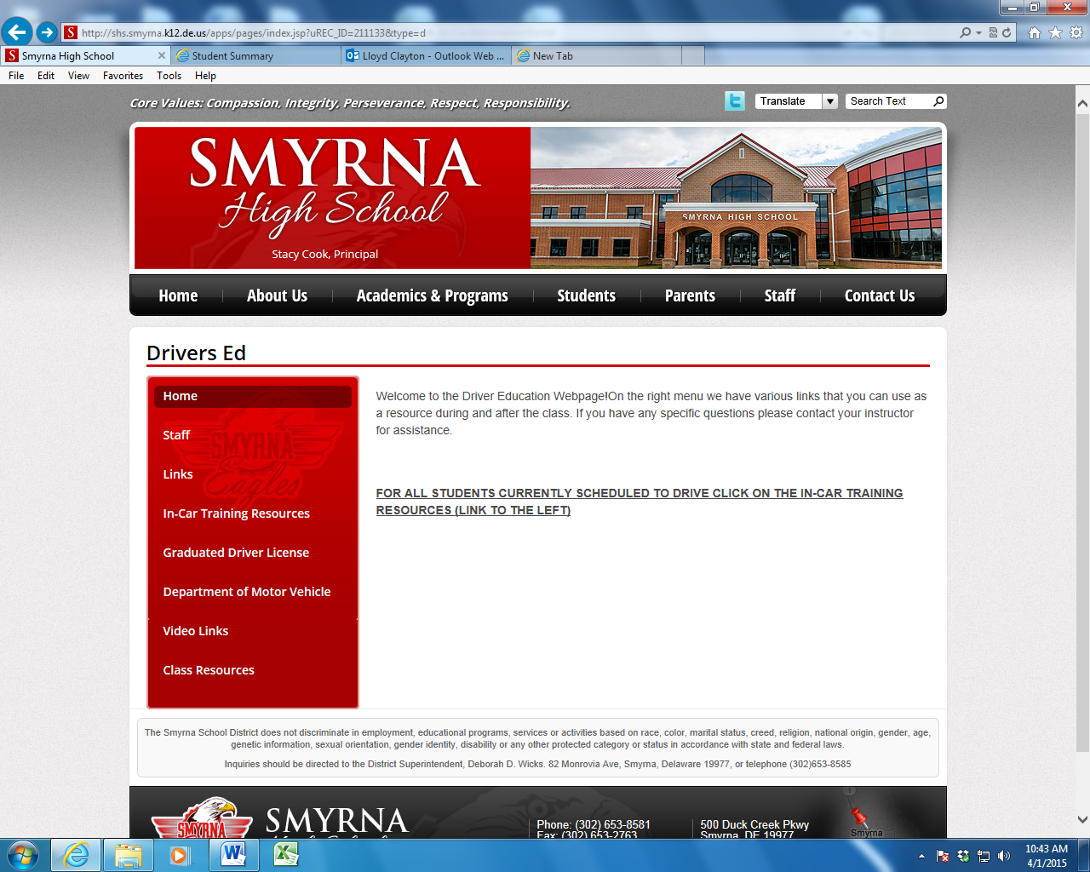
Click In-Car Training Resources

Slide 12
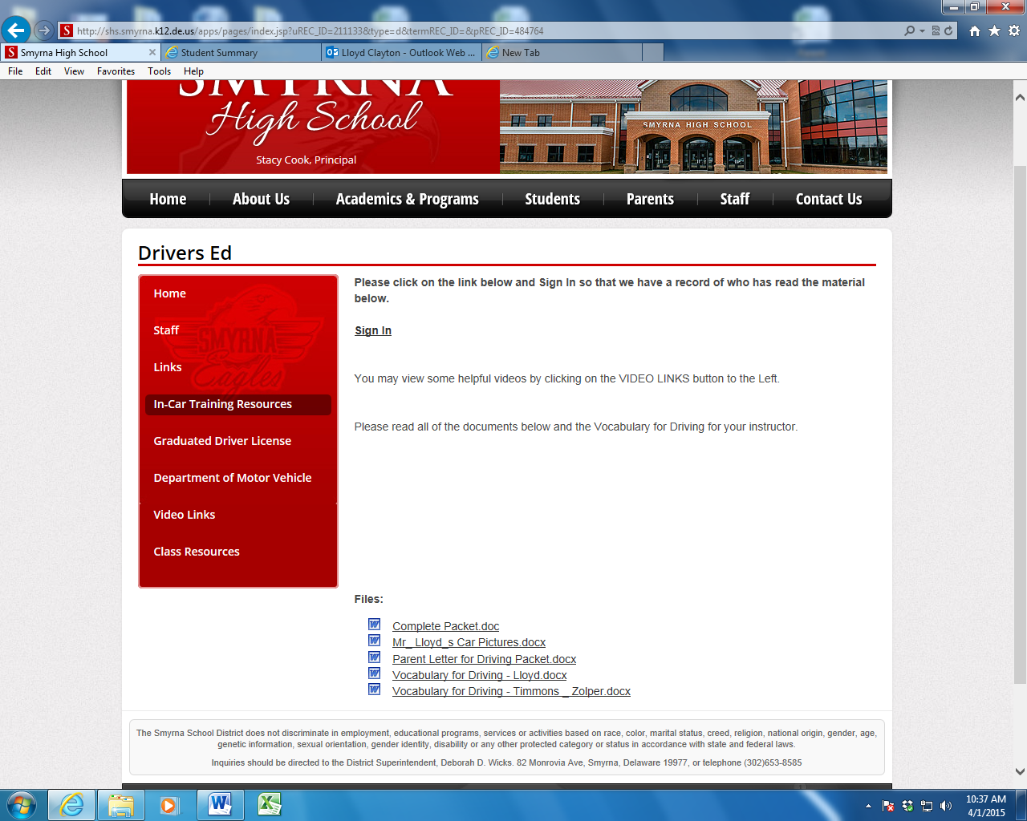
Click Sign In so we have a record of you reading the info
You should read the Complete Packet and the Vocabulary for your teacher BEFORE your first drive.

